Slide 1
TalentTrek: AI-Powered Career Companion
Project Advisor: Vijay Eranti
Konuri, Saipraneeth (MS Software Engineering)
Velicheti, Sri Anudeep (MS Software Engineering)
Mullapudi, Bhargav Krishna (MS Software Engineering)
Appari, Sri Vinay (MS Software Engineering)

Slide 2
Introduction
Challenge: Job seekers face fragmented platforms, ATS rejection, and lack of interview readiness support in the tech industry.
Solution: TalentTrek offers a unified AI-powered platform for job search, resume tailoring, mock interviews, and application tracking.
AI Features: Includes resume and cover letter optimization, real-time feedback during mock interviews, and skill gap analysis.
User Experience: Intuitive UI with smart job filtering, Google OAuth login, and personalized job application insights.
Target Users: Designed for new grads and visa-seeking professionals needing guidance through the hiring lifecycle.

Slide 3
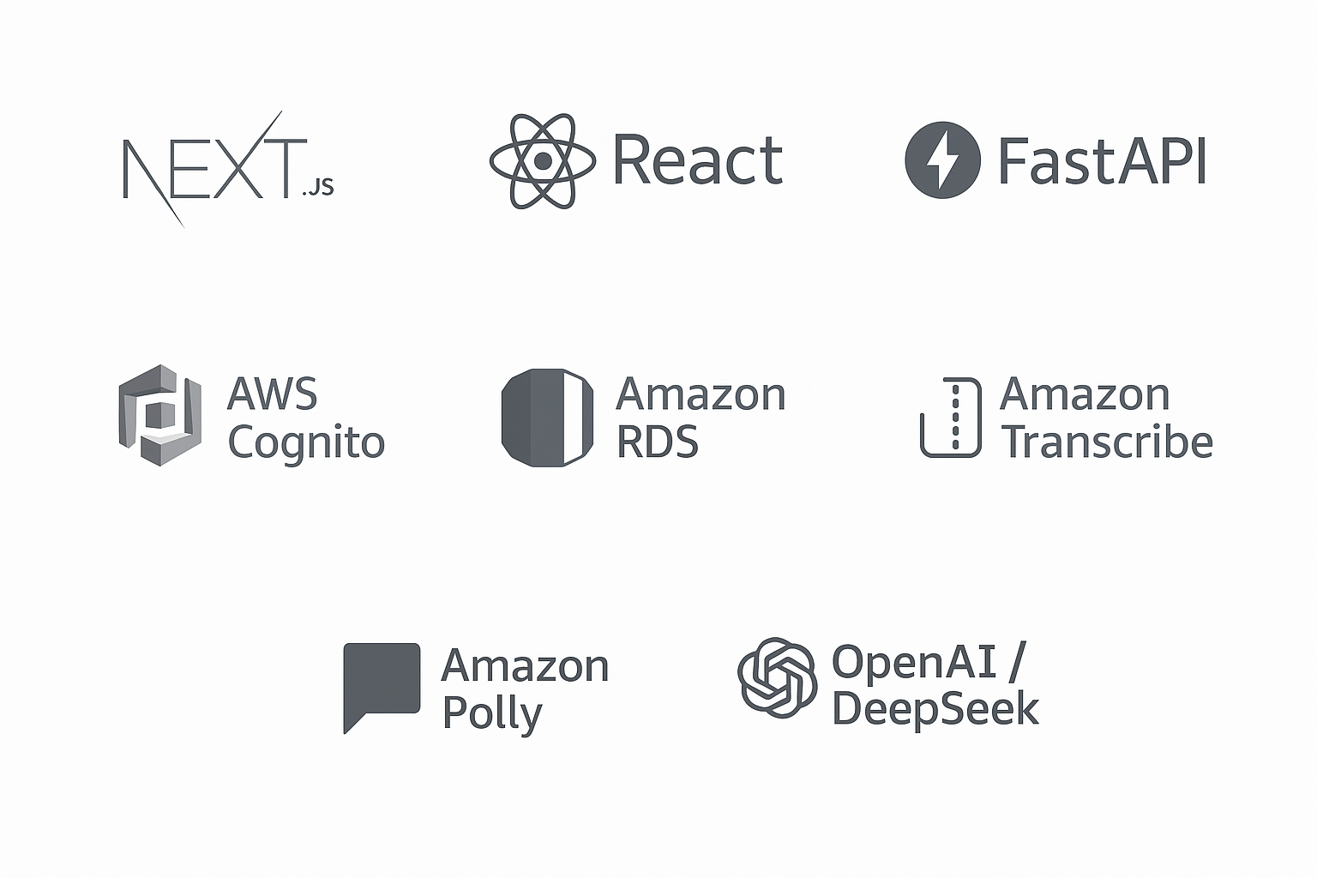
Tech Stack Used

Slide 4
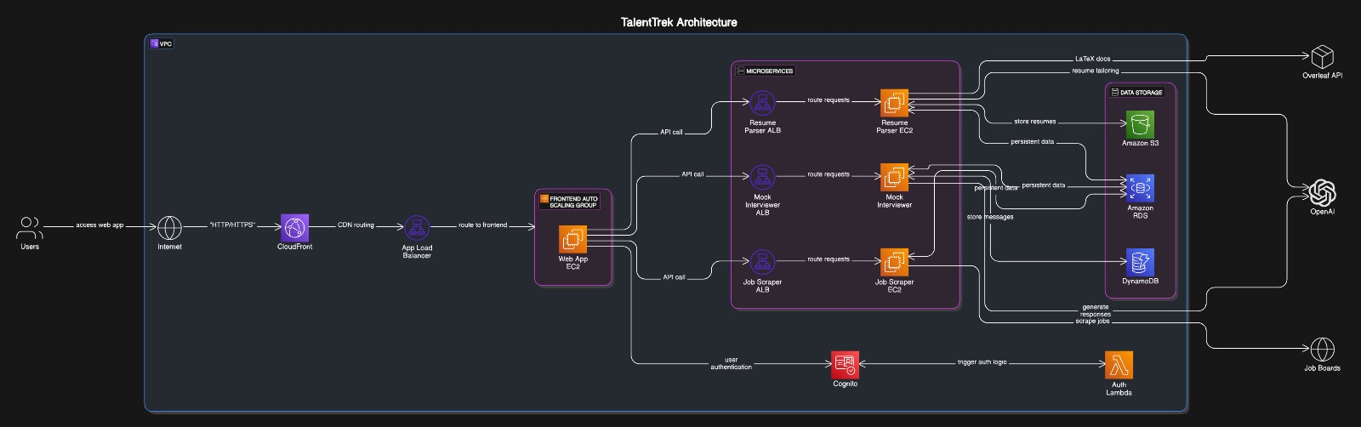
Project Architecture
*Made in draw.io

Slide 5
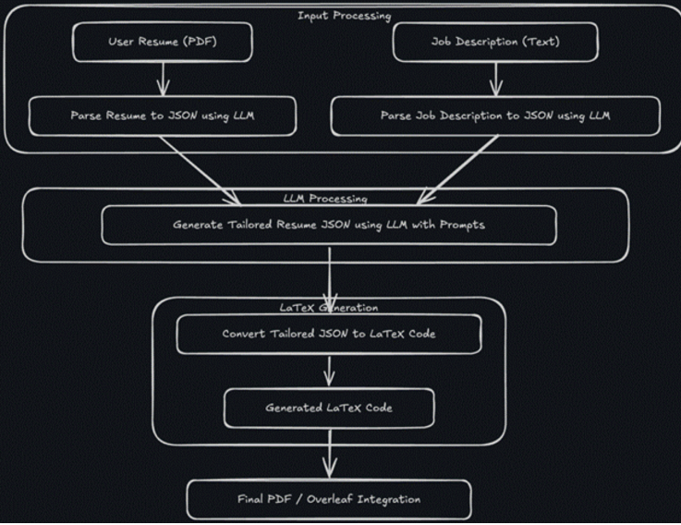
Resume Customisation Flow
*Made in draw.io

Slide 6
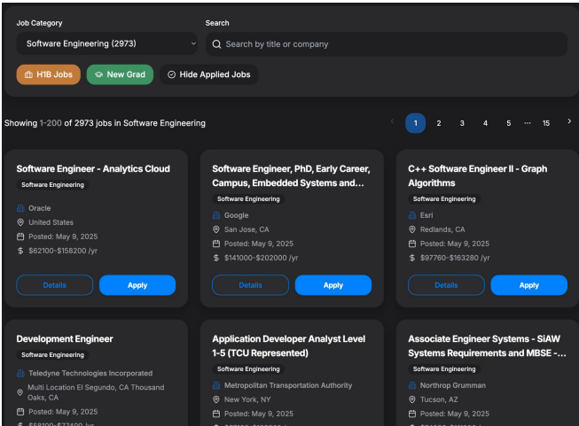
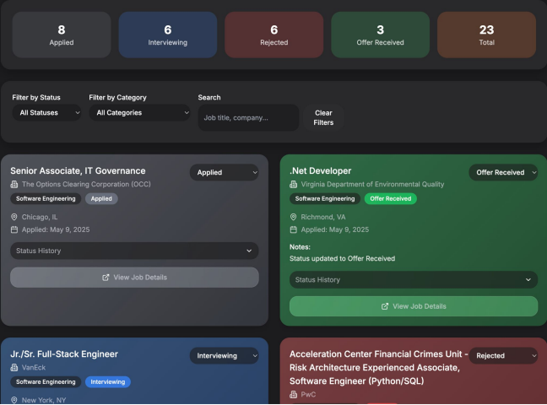
Dashboard and Application Tracking Page

Slide 7
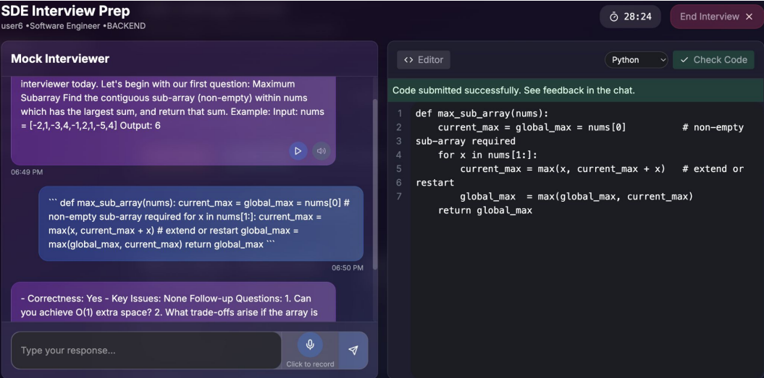

Slide 8
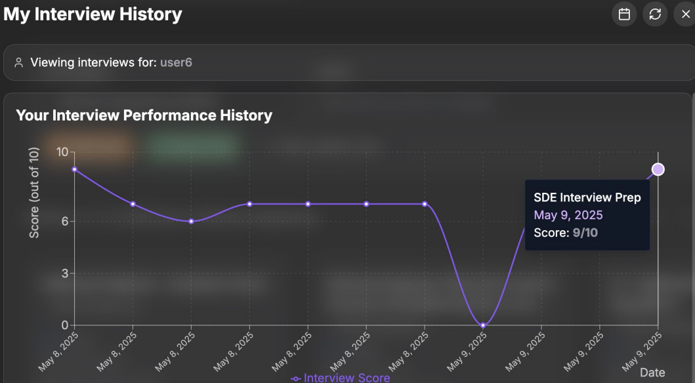

Slide 9
Contributions
Bhargav Krishna Mullapudi | Implemented login functionality and integrated it with other services
Sri Anudeep Velicheti | Developed the Mock Interview module and the feedback engine
Sai Praneeth Konuri | Built the Application Tracking system and Job Board Dashboard
Sri Vinay Appari | Developed the Resume Parsing and Tailoring module

Slide 10
Thank you!

